Slide 1
Australia
The Land Down Under

Slide 2
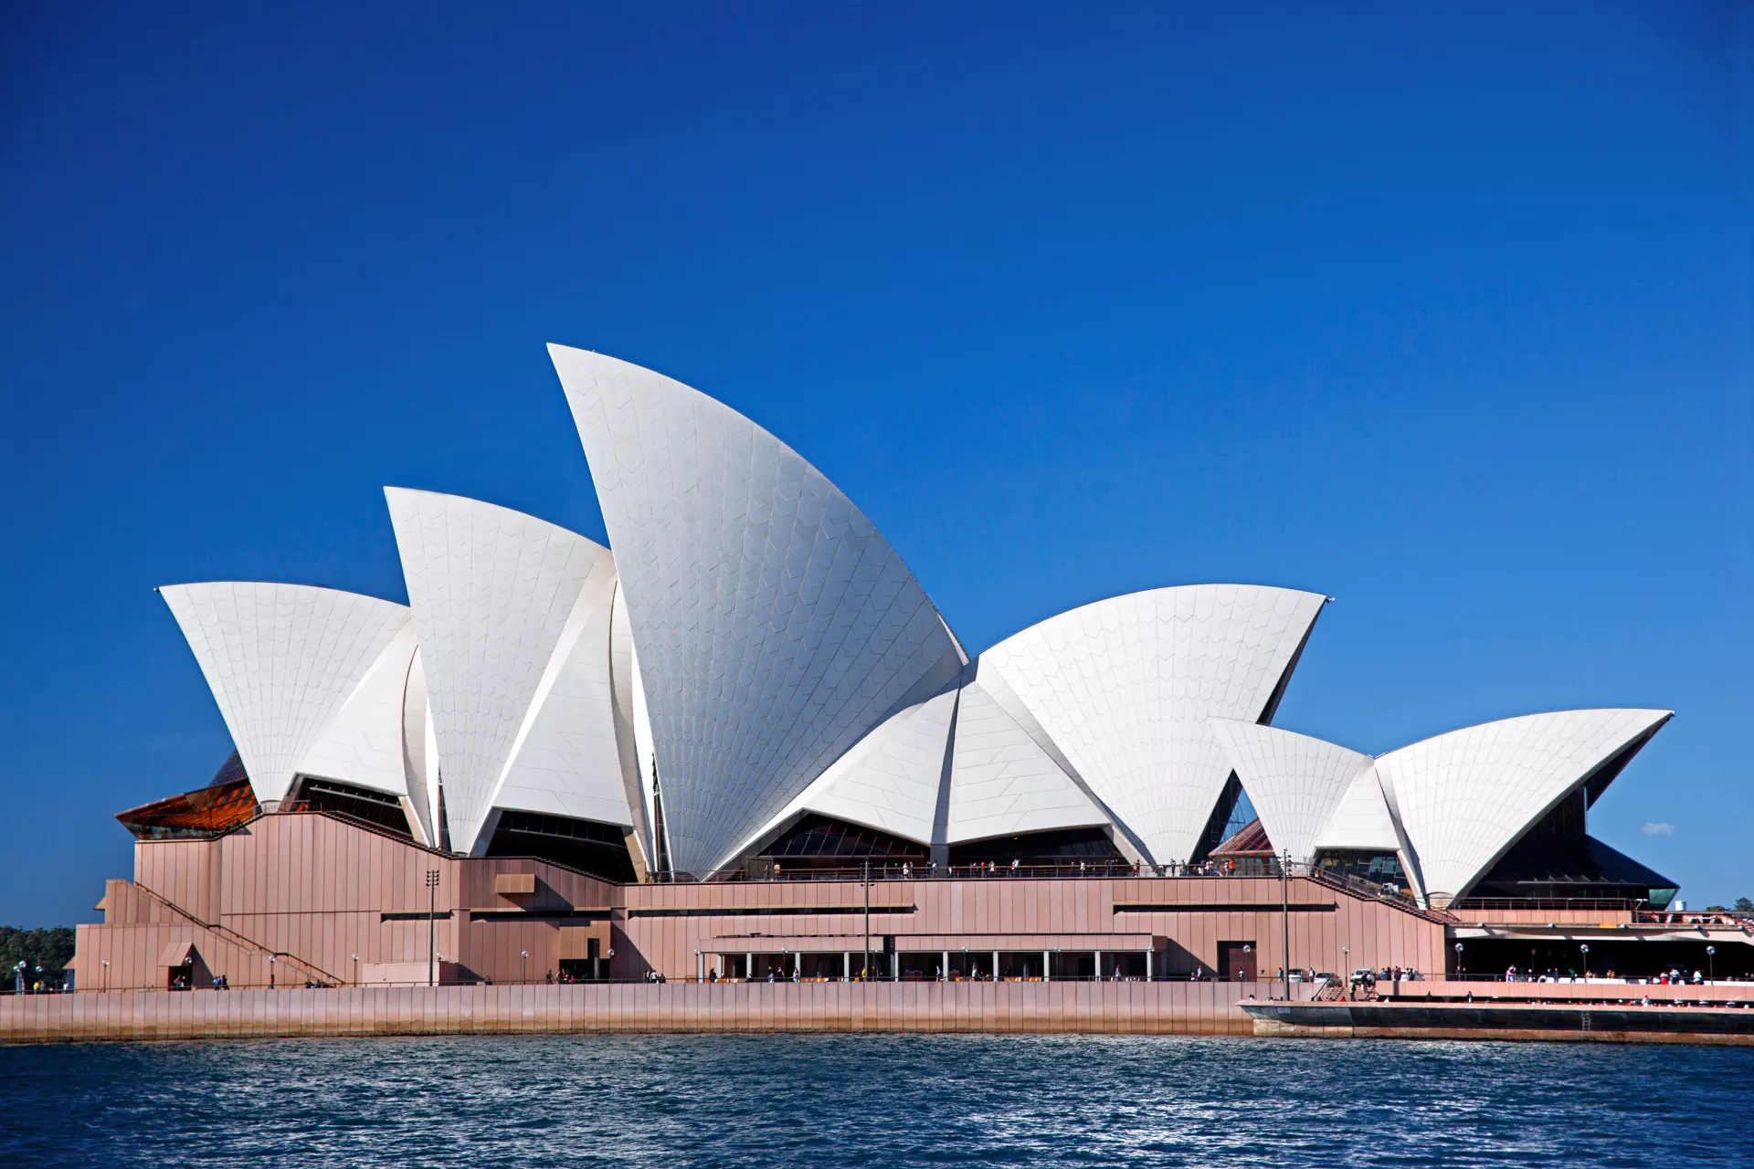
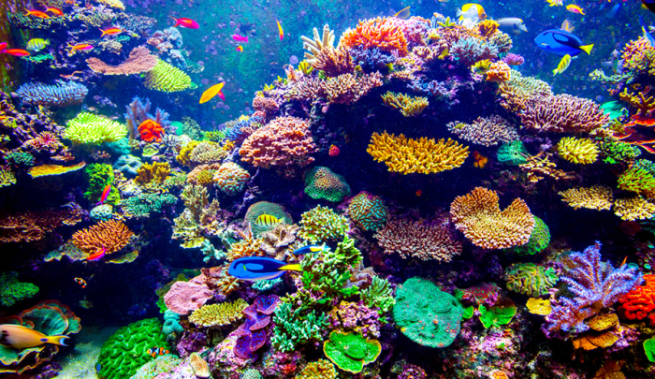
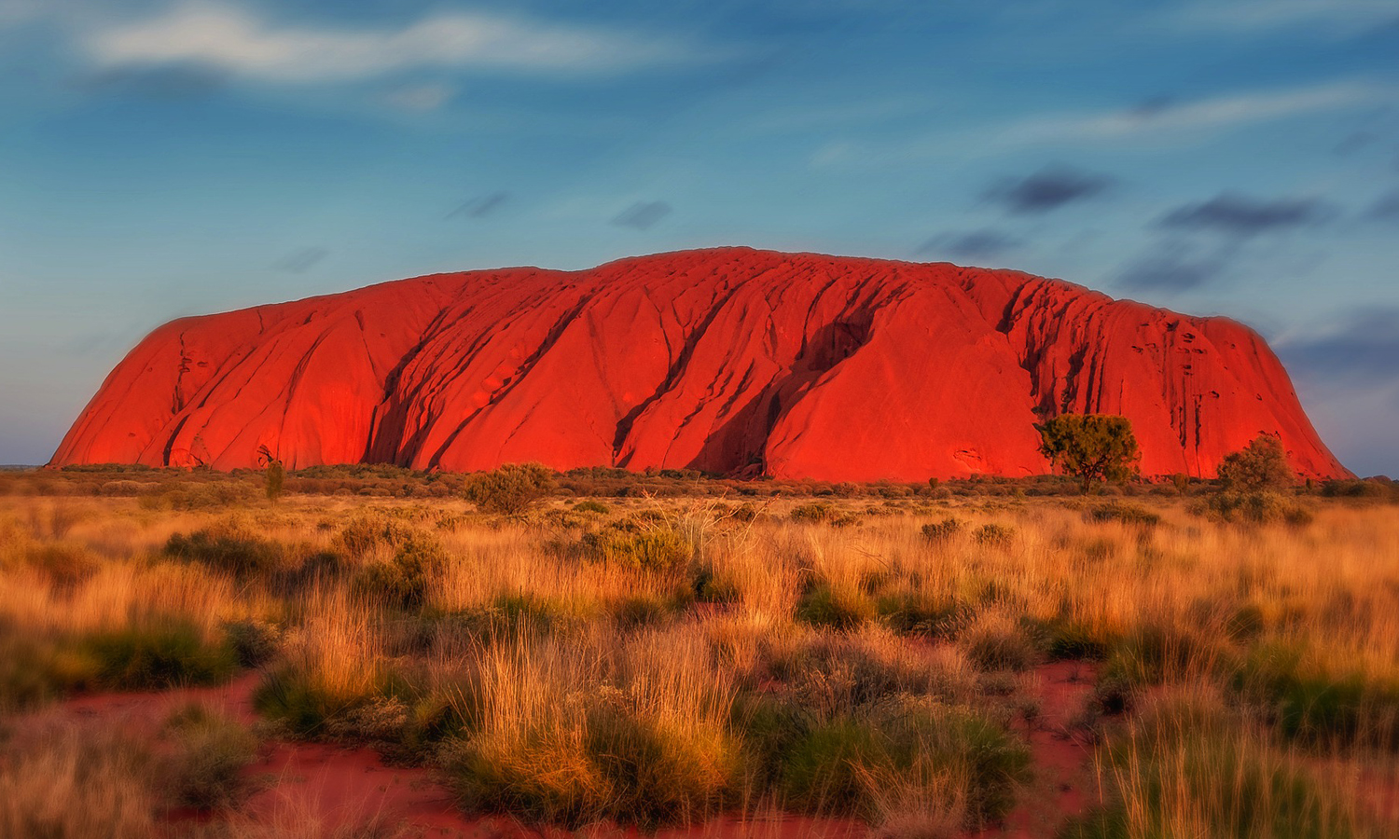
A tapestry of Landscapes

Slide 3
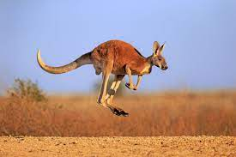
Australia is well known for its unique animals

Slide 4
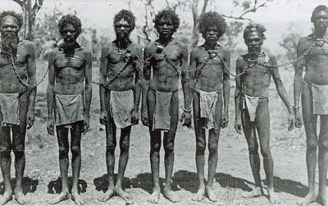
Aboriginals- Indigenous Culture

Slide 5
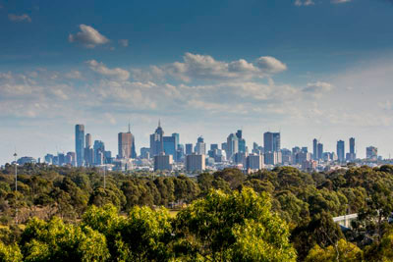
Australia’s biggest cities
Sydney (5.297m)
Melbourne (5.031m)
Brisbane (2.628m)
Perth (2.224m)
Adelaide (1.418m)
Canberra (457k)
Hobart (253k)
Darwin (150k)

Slide 6
Thank you for your attention

